Slide 1


Investing In Real Estate

Slide 2


Introduction
Luxury Lending
Affluent Clients
Commercial Lending
Multi-Tennant
Niche Lending
Private Lending
Construction Financing
Investment Property

Slide 3
Real Estate Market Threats
Inventory Shortage
Artificial Intelligence
Online Brokerage
Short
AI
$$
  Huge disparity between # houses available for sale and # real estate agents
  REX Real Estate Exchange
  2% Commission
  Ad Click: 500 people
  Luxury Homes
  $57.5M in Malibu
  Redfin
  Zillow
  1% Commission
  Purple Bricks - $799 Flat

Slide 4
Inventory Shortage
Canadian Real Estate Association (CREA)
130,000 agents
463,000 homes projected to be sold
3.5 homes per agent

Slide 5
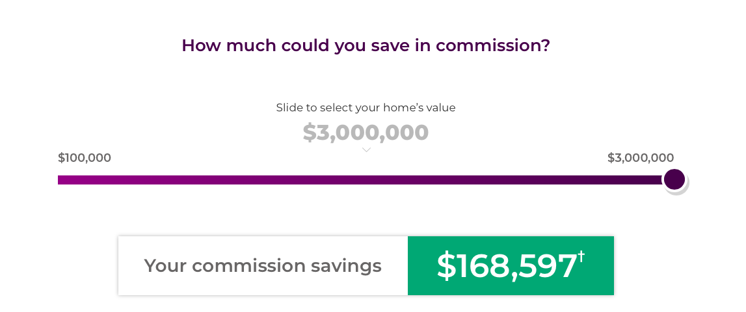
Purple Bricks - $799 Flat Fee

Slide 6
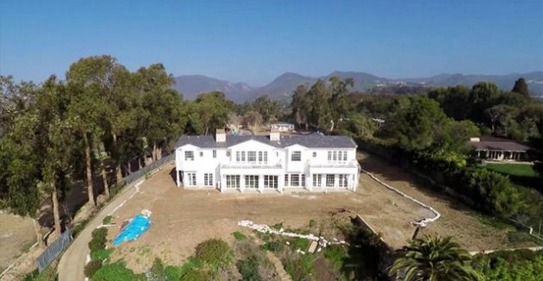
REX – AI Selling Mega Mansions
$44M home sold in Malibu, 2% total fees
Source: REXHomes.com

Slide 7

3 – 5 Year Impact on Your Income

Slide 8
HNW Priorities
HNW clients have 2 main priorities:
1. Ensuring they can maintain their lifestyle into retirement
2. Create Generational Wealth
***You can help them achieve these 2 priorities by showing them the power of investing in real estate!

Slide 9

Create Listings, Create Value
A
B
THE GAP
CURRENT STATE
DESIRED
STATE
WHAT THEY DON’T KNOW OR UNDER ESTIMATE

Slide 10

Investing In Real Estate
“Ninety percent of all millionaires become so through owning real estate”
- Andrew Carnegie

Slide 11

Let Me Tell You A Success Story

Slide 12
Investing In Real Estate
Rental Property Purchase:
$2.5M principal residence
$500,000 purchase price on rental
$125,000 mortgage on principal residence
$375,000 mortgage on rental property

Slide 13
Investing In Real Estate
Monthly Income | Monthly Expenses
$4200 rental income | $2400 mortgage
 | $350 property taxes
 | $200 insurance
 | $250 property manager
 | $150 maintenance
$4200 INCOME | $3350 EXPENSES

Slide 14
Investing In Real Estate
Summary:
$850/month positive cash-flow
Did not use any of their own money to purchase an appreciating asset

Slide 15
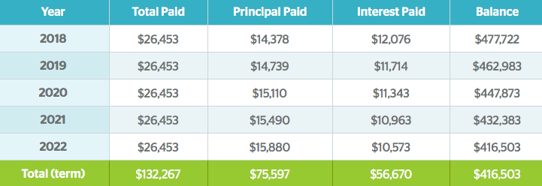

Tenants Pay Your Mortgage

Slide 16
Positive Cash-Flow
$75,000 paid down on mortgage in 5-years
$51,000 net rental income generated in 5-years
$125,000 net worth increase
$0 invested of own capital – 100% financed

Slide 17
Refinance To Purchase More
Mortgage balance is going down
Home value is going up (long term)
Can refinance to purchase other rental properties

Slide 18

Building An Empire

Slide 19
Building An Empire
$500,000 McMaster is now worth $625,000
$75,000 principal paid on the mortgage.
$325,000 owing
80% refinance
$175,000 capital used to purchase another rental property for $625,000

Slide 20
Building An Empire
5-years time:
Investment portfolio has increased to $1.3M ($625K + $625K)
$20,400 in net rental income

Slide 21
Create Listings, Create Value
A
B
THE GAP
CURRENT STATE
DESIRED
STATE
WHAT THEY DON’T KNOW OR UNDER ESTIMATE

Slide 22
Next Steps – A Listing Blueprint
Create Listings From Your Existing Clients:
Identify Event Parameters – where, when, who
2. Event invitations
3. Follow-up phone calls to confirm
4. Deliver seminar – co-present

Slide 23
Next Steps – A Listing Blueprint
Make Investing Easy For Your Clients
1. Identify where & what to invest in
2. Draw up cash-flow projection using spreadsheet
3. Have property management available
4. Sell, sell, sell!

Slide 24
Investing In Real Estate
Thank-You!

